Slide 1
Replicating the Facebook Hack
Miners Cyber Security Club

Slide 2
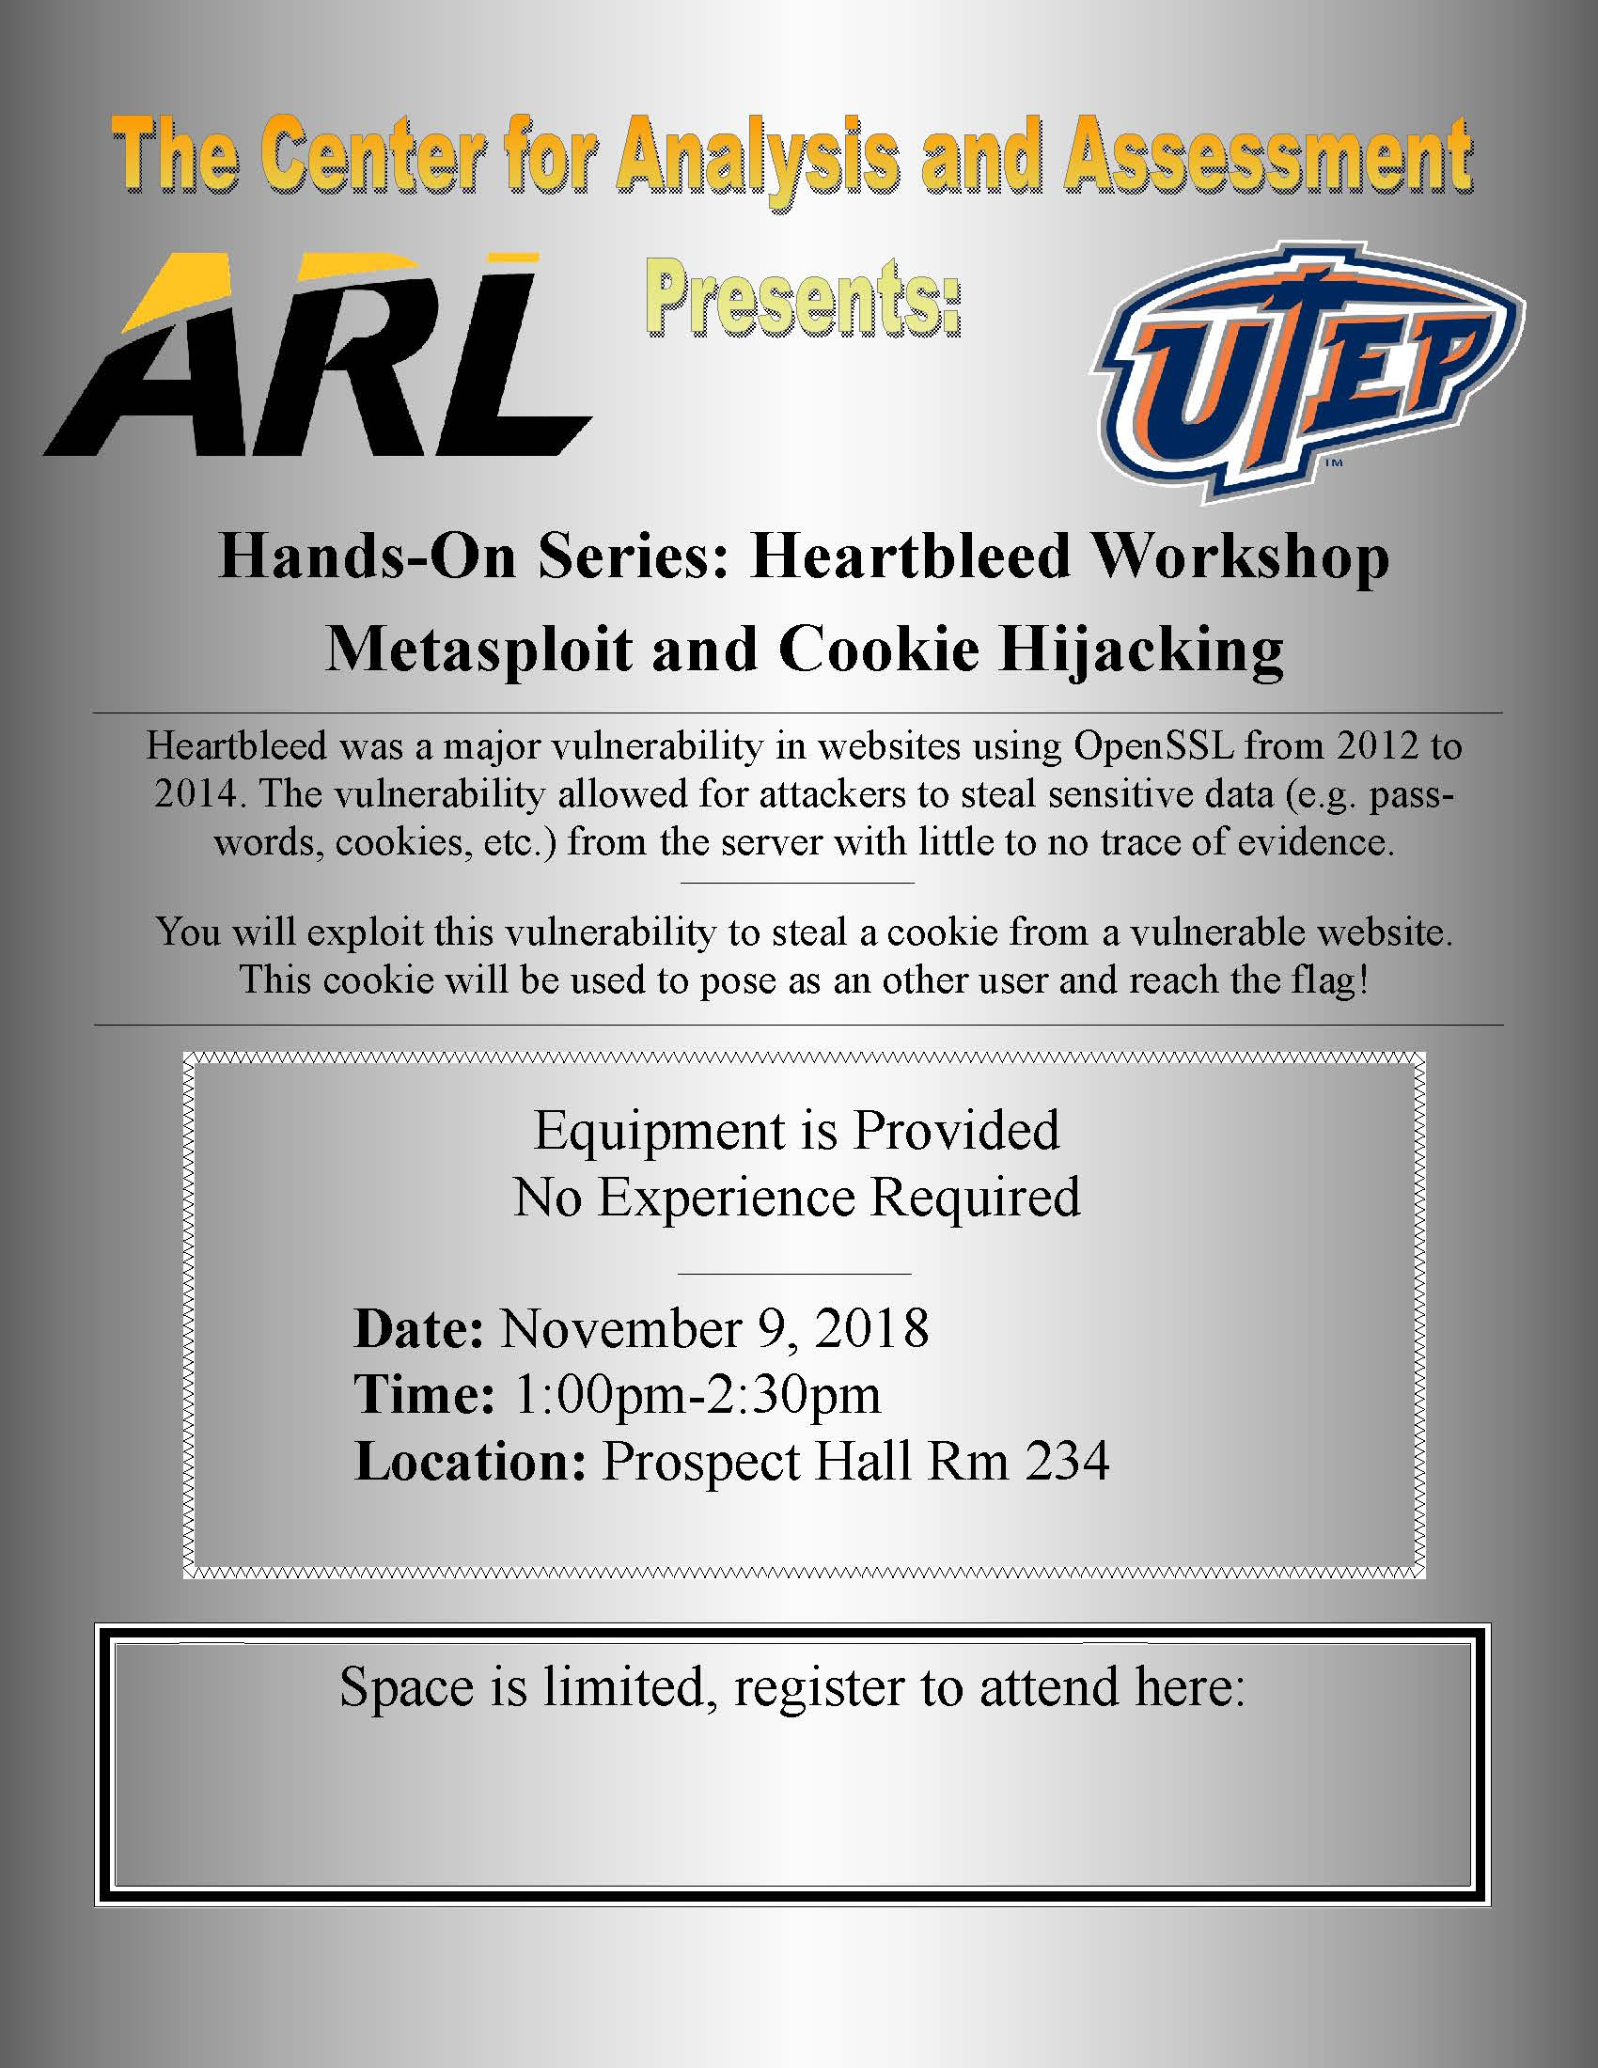
Announcement

Slide 3
Background
Affected about 30 million accounts
Personal information stolen
Vulnerability existed from July 2017 and September 2018
Unusual spike on September 14, 2018

Slide 4
But How?
Bug in FB’s “view as” should have had view only permissions
Instead feature allowed people to upload videos
Video uploader introduced invalid access token
Token had permission of mobile app

Slide 5
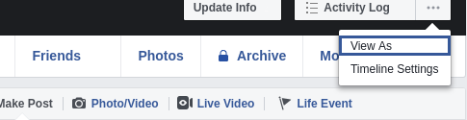
But How?
Access token generated was for person you were looking up
Access token was found in HTML code
All these allowed attacker to pivot from user to user

Slide 6
Try It Yourself!
https://facebook-history.adversary.io/

Slide 7
Reference
https://newsroom.fb.com/news/2018/09/security-update/
DISCORD CHAT Server Invite: MAfDkvs

